Slide 1
Data Visualization
Zack Dai

Slide 2
Why Charts?
It is a story

Slide 3
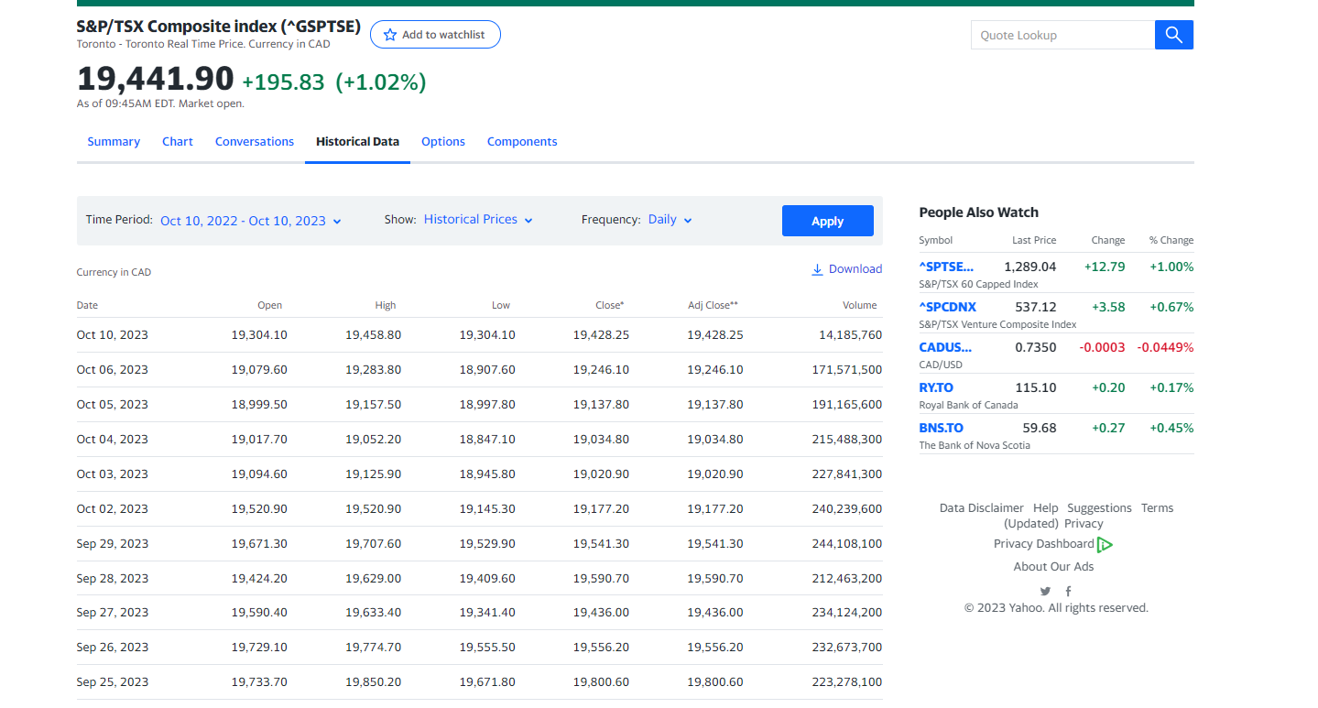
Consider this dataset
What do you see here?
https://ca.finance.yahoo.com/quote/%5EGSPTSE/history?p=%5EGSPTSE

Slide 4
Visualization with Excel
With the chart it is easy to find:
Trend
Pattern
Special Event
Correlations
STORY

Slide 5
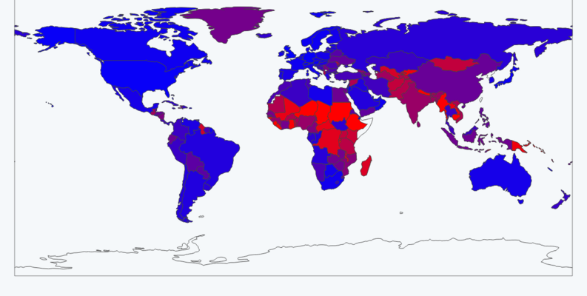
Pivot Table & Pivot Chart
https://www.kaggle.com/datasets/yusufglcan/country-data

Slide 6
Visualization with Python
Repeatable, at large scale, fast, in production

Slide 7

Libraries

Slide 8
Pandas and Colab
from faker import Faker
import pandas as pd
fk = Faker()
data = [fk.profile() for _ in range(100)]
df = pd.DataFrame(data)
df.head()

Slide 9
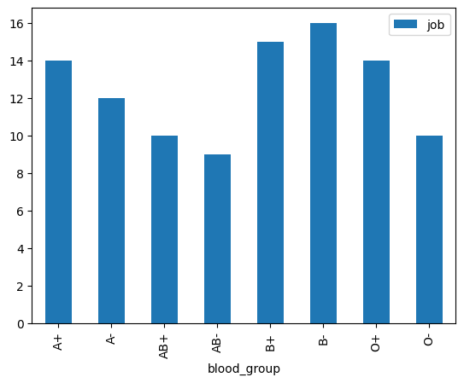
Aggregate and plot
blood_group = df.groupby('blood_group')['job'].count().reset_index()
blood_group
blood_group.plot.bar(x='blood_group', y='job')

Slide 10
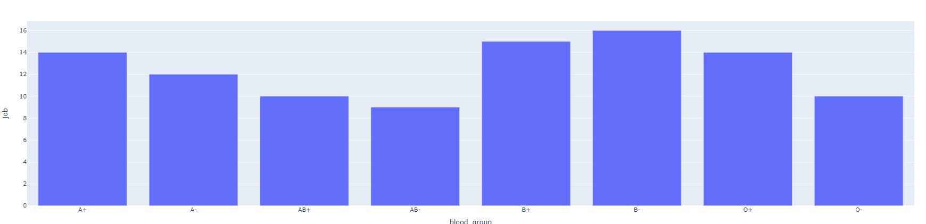
Interactive chart with Plotly
As pandas backend
pd.set_option('plotting.backend','plotly')
blood_group.plot.bar(x='blood_group', y='job’)
Plotly origin
from plotly import express as px fig = px.bar(blood_group, x='blood_group', y='job')
fig.show()

Slide 11
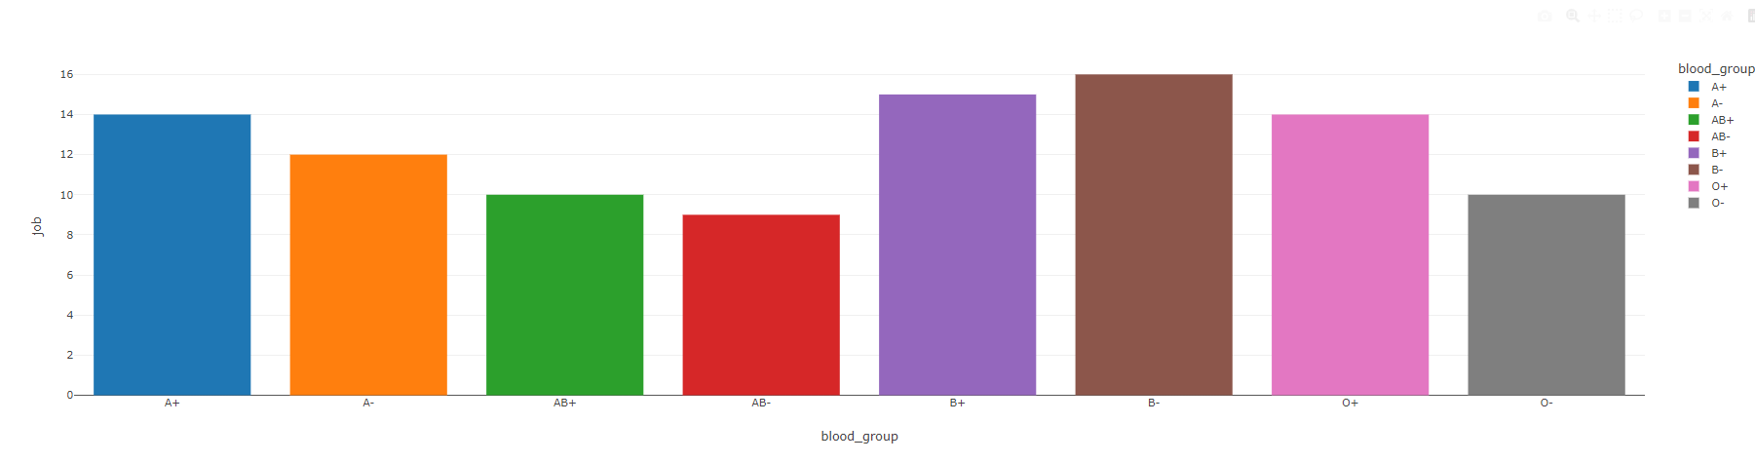
Plotly themes
https://plotly.com/python/templates/
Set Temporarily
fig = px.bar(blood_group, x='blood_group', y='job', template='none’)
Set Permenately
from plotly import io as pio
pio.templates.default = 'none’
Color sets
color_discrete_sequence=px.colors.sequential.RdBu
https://plotly.com/python/builtin-colorscales/

Slide 12
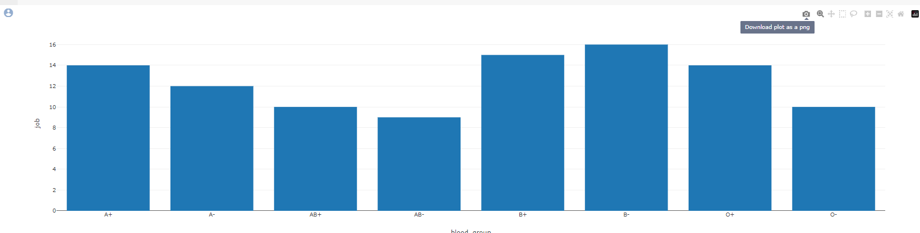
Chart interaction and save to file
fig.write_html('blood_group.html')

Slide 13
Chart types
Your story decide which to pick

Slide 14
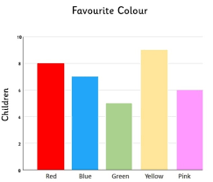
Bar chart
When to Use Bar Charts
Comparing Categories: Use bar charts when you want to compare different categories or groups of data against each other.
Displaying Discrete Data: They are effective for displaying discrete or categorical data.
Pros of Bar Charts
Clarity: Provide a clear and straightforward way to represent data, making it easy for the audience to understand and interpret.
Easy to Interpret: Intuitive and require minimal effort to interpret, even for individuals with limited data literacy.
Accurate Comparison: Facilitate accurate comparison of data points, especially when dealing with multiple categories.
Suitable for Large Data Sets: Can effectively handle large amounts of data without becoming cluttered or confusing.
Cons of Bar Charts
Limited for Continuous Data: Not suitable for representing continuous data or data with a large number of categories.
Less Effective for Trends: May not be the best choice for displaying trends over time compared to other chart types like line graphs.
Less Aesthetic Flexibility: Limited in terms of design and customization options compared to some other chart types.
Potential for Misrepresentation: Depending on scale and labeling, bar charts can be used to manipulate perceptions of data.

Slide 15
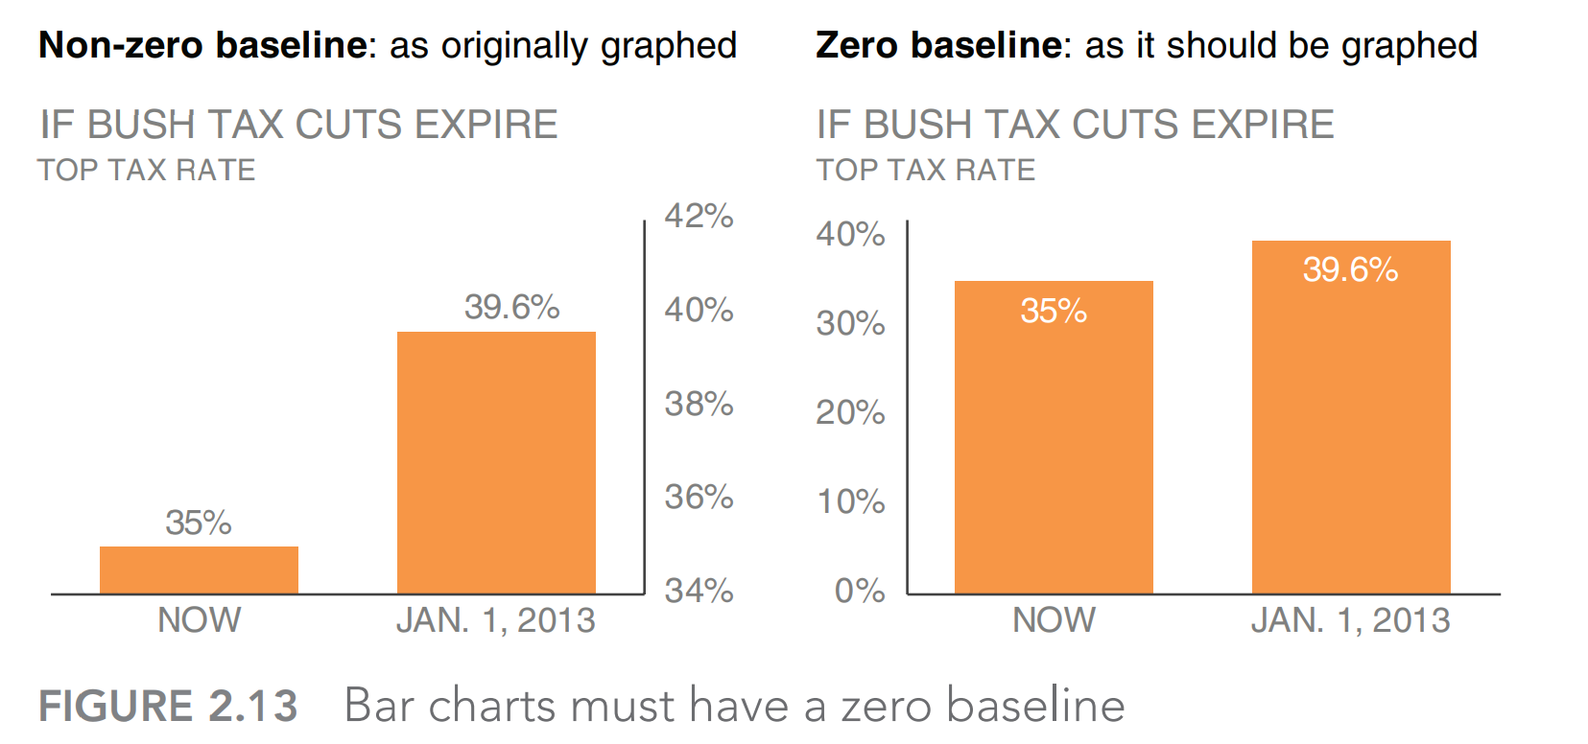
How Bar chart Lies

Slide 16
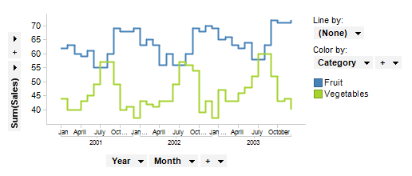
Line charts
When to Use Line Charts
Visualizing Trends: Utilize line charts to display trends or patterns over a continuous interval, such as time.
Showing Relationships: Effective for illustrating relationships or correlations between variables.
Highlighting Change Over Time: Ideal for emphasizing changes and fluctuations in data points across a defined period.
Pros of Line Charts
Highlight Trends: Exceptional at highlighting trends and patterns in data, providing a clear visual representation.
Effective for Time Series Data: Particularly useful for displaying data points that are collected sequentially over time.
Emphasis on Continuity: Emphasize the continuous nature of data, aiding in the understanding of gradual changes.
Facilitates Forecasting: Helps in making predictions or forecasting based on historical data trends.
Cons of Line Charts
Not Ideal for Categorical Data: Less effective when dealing with categorical or discrete data sets.
Less Suitable for Comparisons: May not be the best choice when comparing individual data points across different categories.
Complex for Large Datasets: Handling large datasets with numerous data points can lead to a cluttered and hard-to-interpret chart.
Misleading Without Context: Without proper labeling and scaling, line charts can potentially misrepresent data trends.

Slide 17
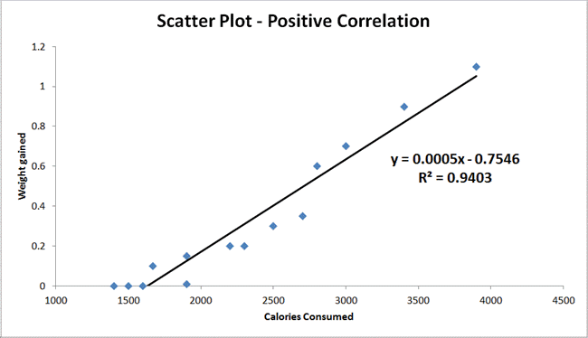
Scatter plot
When to Use Scatter Charts
Visualizing Relationships: Utilize scatter charts to examine relationships or correlations between two continuous variables.
Identifying Outliers: Effective for identifying outliers or unusual data points within a dataset.
Displaying Clusters or Patterns: Ideal for showcasing clusters, patterns, or groupings in data.
Pros of Scatter Charts
Visualizing Relationships: Excellent at revealing the strength and direction of relationships between variables.
Spotting Outliers: Provides a clear visual indication of outliers or data points that deviate from the norm.
Useful for Predictive Modeling: Essential in regression analysis and building predictive models.
Effective for Small Data Sets: Particularly useful when dealing with smaller datasets with limited data points.
Cons of Scatter Charts
Not Suitable for Categorical Data: Less effective when dealing with categorical or discrete data sets.
Limited in Data Representation: Can only represent two variables at a time, which may not be sufficient for complex data analysis.
Requires Context: Interpretation may be challenging without proper context or additional supporting information.
Potential for Overplotting: With a high density of data points, the chart can become cluttered and harder to interpret.
px.scatter(df_iris, x='sepal_width', y='sepal_length', color='species', size='sepal_length', trendline='ols')

Slide 18
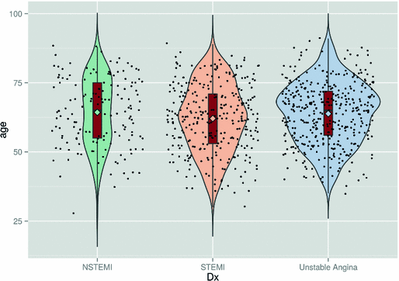
Violin and Box Plot
Violin Plot
Pros:
Displays Distribution: Provides a visual representation of the data's probability distribution, offering insights into its shape and spread.
Shows Density: Indicates data density at different values, aiding in identifying modes and clusters within the data.
Suitable for Small Datasets: Especially effective for smaller datasets where individual data points need emphasis.
Combines Box Plot and Kernel Density Plot: Offers a hybrid view of both summary statistics (box plot) and detailed distribution (kernel density plot).
Cons:
Complex Interpretation: May be more complex to interpret for individuals unfamiliar with the plot type.
Space-Intensive: Takes up more space compared to traditional box plots, potentially making visuals crowded in presentations.
.
px.violin(df_iris, y='sepal_width', color='species', points='all', box=True)

Slide 19
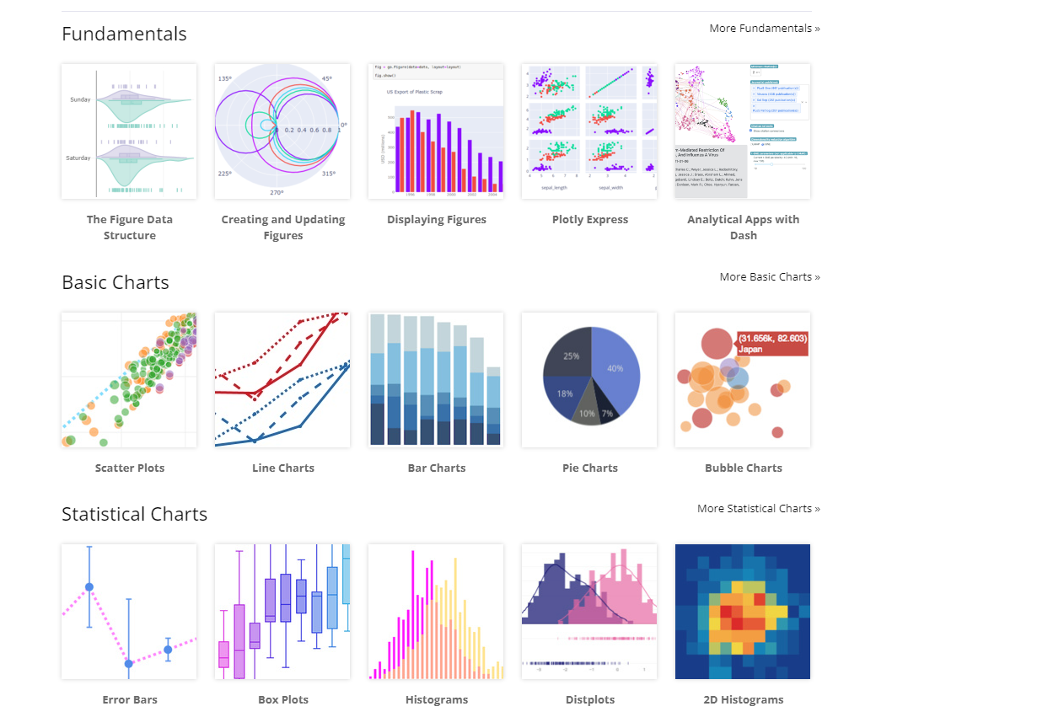
Other types of charts
https://plotly.com/python/

Slide 20
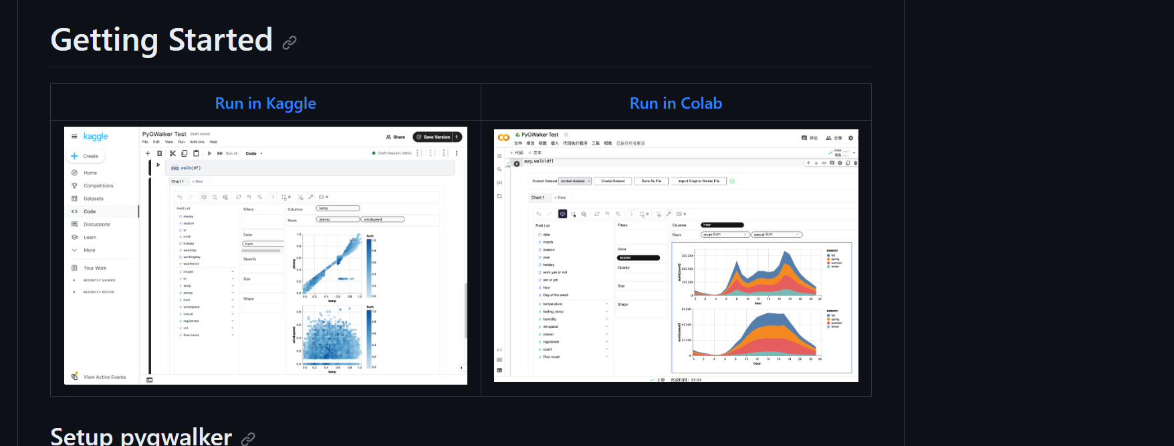
Low code visualization
https://github.com/Kanaries/pygwalker
Example: https://colab.research.google.com/drive/1jLve72KRFT-B6x8C3Z-wqtV5NSCV3klF#scrollTo=cjo4noUQbRKP

Slide 21
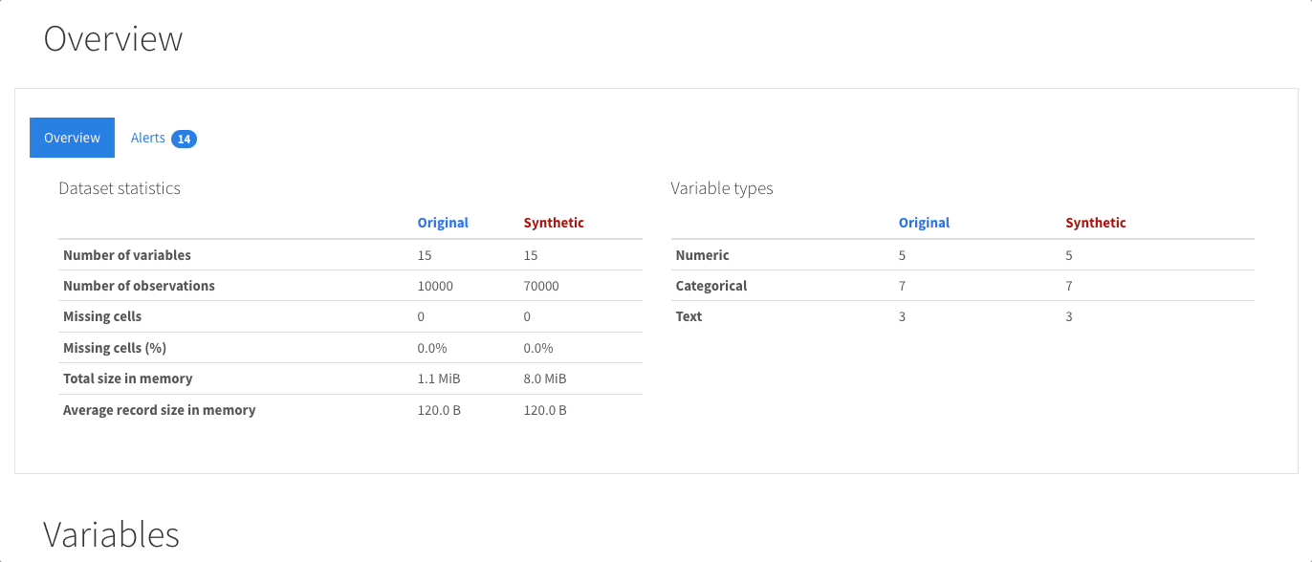
Auto Data Frame analyzer
https://docs.profiling.ydata.ai/4.6/

